Slide 1
SC2001/CE2101/CZ2101:
Algorithm Design & Analysis
Course Introduction
Asst. Prof. LIN Shang-Wei

Slide 2

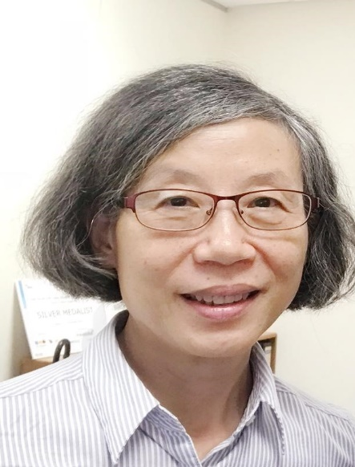
Instructors
LIN Shang-Wei, PhD
shang-wei.lin@ntu.edu.sg
Office: N4-02C-86
Huang Shell Ying, PhD
assyhuang@ntu.edu.sg
Office: N4-02B-38
Consultation Hours: By appointment

Slide 3
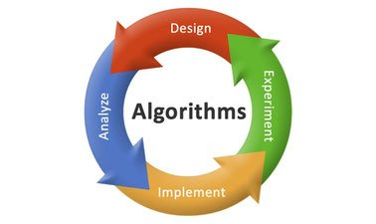
Syllabus
  Sorting (Weeks 1-4)
  Graphs (Weeks 4-6)
  Analysis Techniques (Weeks 7-8)
  Dynamic Programming (Weeks 8-10)
  String Matching (Weeks 11-12)
  Introduction to NP Completeness (Weeks 12-13)

Slide 4
Learning Objectives & Outcomes
Apply, design and analyse algorithms for
  sorting, graph problems (Weeks 1-6)
  string matching, and certain types of optimization problems (Weeks 7-13)
Upon completion of the course, the student should be able to:
  Design algorithms using suitable strategies (e.g., incremental, divide-and-conquer, greedy, dynamic programming) to solve a problem.
  Analyse the efficiency of different algorithms for problems studied.
  Understand complexity classes P & NP; apply greedy approach to solve NP-complete problems.
  Implement algorithms from pseudo code into real code.

Slide 5
Learning Plan
Week | Lecture Topic | Tutorial | Example Classes
1 | Introduction & Sorting (Insertion Sort)
2 | Sorting (Mergesort & Quicksort)
3 | Sorting (Quicksort & Heapsort) | Sorting (T1)
4 | Sorting (Heapsort) & Graphs (Greedy strategy) | Sorting
5 | Graphs (Dijkstra’s algorithm & Prim’s algorithm) | Sorting
6 | Graphs (Union-find & Kruskal’s algorithm) | Graphs (T2) | Project 1
7 | Analysis techniques | Graphs | Project 1
 | Recess Week
8 | Analysis techniques, Dynamic programming | Graphs | Project 2
9 | Dynamic programming | Analysis Techniques (T3) | Project 2
10 | Dynamic programming | Dynamic Programming (T4) | Quiz
11 | String Matching | Dynamic Programming | Quiz
12 | String Matching, Introduction to NP | String Matching (T5) | Project 3
13 | Introduction to NP | Introduction to NP (T6) | Project 3

Slide 6
Lecturing Mode (Week 1-6)
  Lectures: 2 hours per week
    Monday, 12:30-13:30
    Friday, 16:30-17:30

Slide 7

Assessments
Assessment | Percentage
Example Classes (Team) | 20%
Quiz (Individual) | 20%
Final Exam (Individual) | 60%

Slide 8

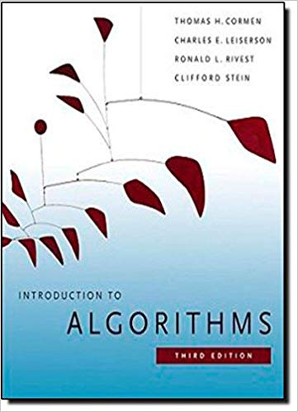
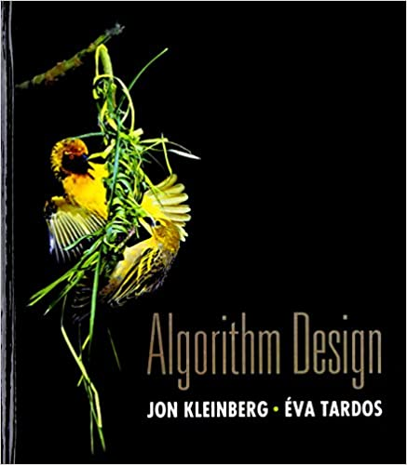
References
Computer Algorithms: Introduction to Design and Analysis. Sara Baase & Allen Van Gelder, 2000. Third Edition. Addison Wesley. ISBN-10: 0-201-61244-5
Introduction to Algorithms. Thomas H. Cormen, Charles E. Leiserson, Ronald L. Rivest, and C. Stein, 2009. Third Edition. The MIT Press.
Algorithm Design. J. Kleinberg and E. Tardos, 2005. Addison Wesley.

